Slide 1
Talk about the Weather: Art and Climate Change
by Michael McCanne (August 16, 2018)
Notes:
https://www.artinamericamagazine.com/news-features/news/talk-weather-art-climate-change/

Slide 2
Tavares Strachan:
Sometimes Lies are Prettier, 2017

Slide 3
The exhibition engages with “some of the many challenges—scientific, cultural, personal, psychological—that climate change has brought to humankind.”

Slide 4
Steve Rowell
Midstream at Twilight (2016)

Slide 5
Black Ghosts: Basquiat’s “Defacement” at the Guggenheim
by Tiana Reid (July 17, 2019)

Slide 6
Jean-Michel Basquiat: The Death of Michael Stewart, 1983
Notes:
https://www.artinamericamagazine.com/news-features/news/basquiat-defacement-guggenheim-protests-racist-violence/

Slide 8
We Are In A Cultural Holocaust
By Noah Becker (August, 2019)
Notes:
https://whitehotmagazine.com/articles/we-are-in-cultural-holocaust/4368

Slide 9
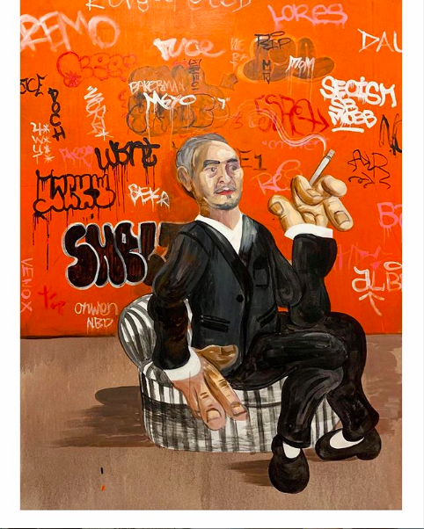
Figure on a Couch, 2019

